Slide 1
Miner Monsters
Erik Hanley
David Dempsey

Slide 2
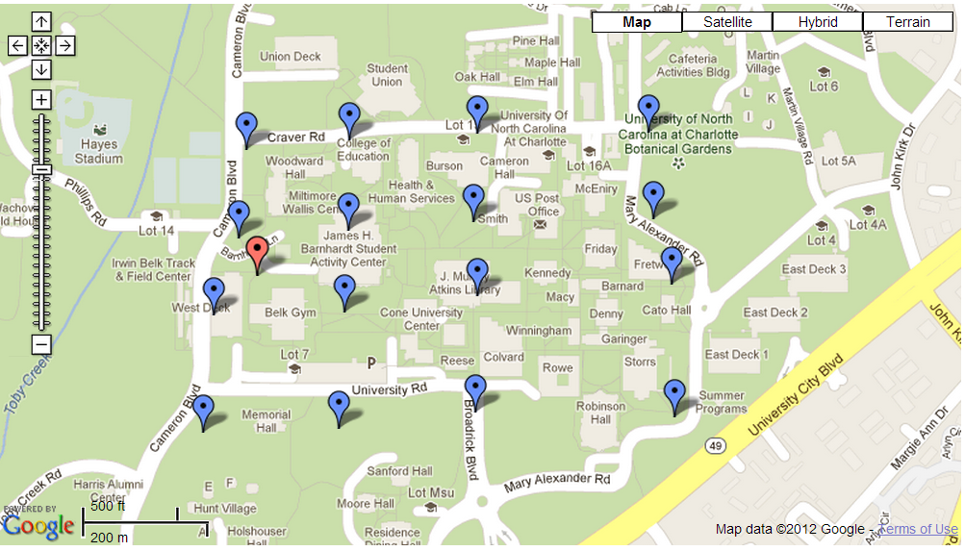
GPS Integration
Different types of monsters appear when scanning according to GPS location.
Monster type 4 appears here.

Slide 3
Storing Monsters
Users have the ability to store up to two monsters at a time
Shared preferences, using an xml file, are used to retain monster data even after the device is turned off

Slide 4
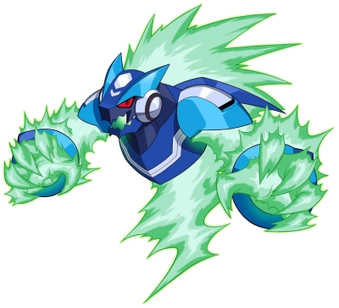
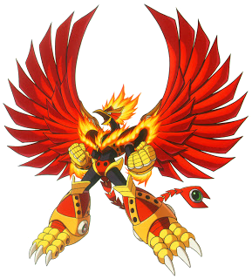
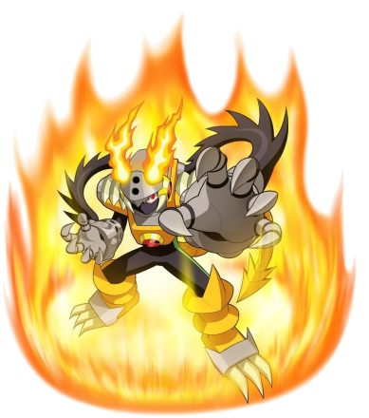
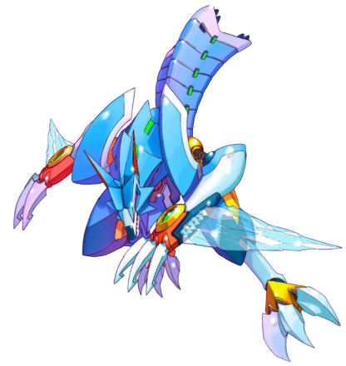
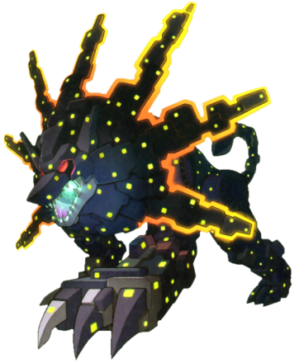
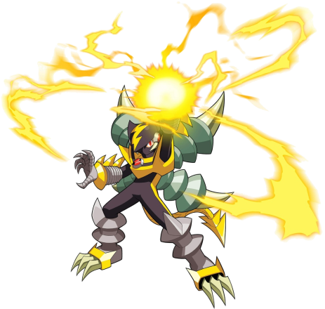
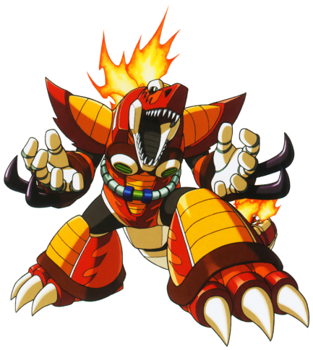
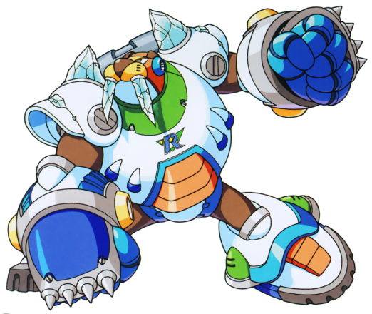
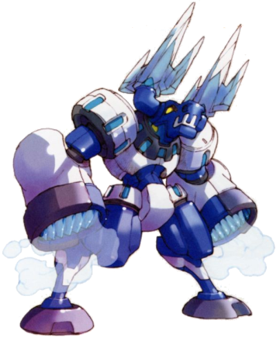
View Monster
Users can view stored monster data at any time.
Keep track of the monster’s stats and experience.
all images are copyright to Capcom

Slide 5
Battle Monsters
Users start single player by selecting a stored monster to use in battle
Users are then matched randomly with a monster of equal or greater strength
Each monster has different stats and elements

Slide 6
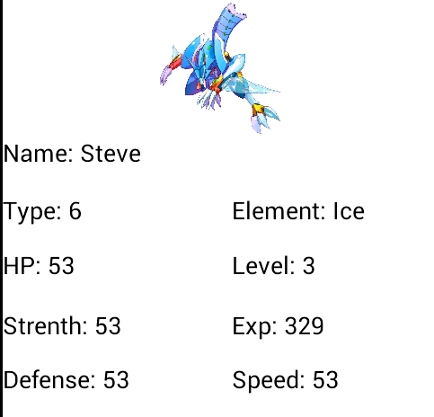


Grow Stronger!

Slide 7
Battle Example!

Slide 8
Future Add-ons
Bluetooth connection with other users for one-on-one battles
Special attacks for specific monster types and element types
Increased range for finding and capturing monsters

